Slide 1
Inferential Dynamics Truth as a Stable Attractor of Reason
By: Mr. Cole Prather
Oct 7th, 2025

Slide 2
Outline
Motion, Stability, and Feedback
Examples of Feedback Systems
Language of Stability
Mathematics of Stability
Visualizing Stability
Forms of Motion and Modes of Inference
Inference as a Dynamical System
Truth as a Stable Attractor
Comparing Modes of Inferences
Lines of Reasoning and Critical Path
Summary and Conclusion
Discussion and Questions

Slide 3
“Since nature is a principle of motion and change, and since our inquiry is about nature, we must not overlook the question of what motion is. For without understanding motion, we could not understand nature.” – Aristotle

Slide 4
Motion
Question:
Why do some motions settle down, while others escalate, and some just continue as they are?
Aristotle: Constant Force = Constant Motion
Galileo: Constant Force = Constant Acceleration
Forces are not needed to maintain motion, only to change it.

Slide 5
Stability
No forces = no change in motion (equilibrium)
Static vs Dynamic Equilibrium
Forces cause change, and require energy
Systems often tend toward low energy states
Some systems can achieve other bounded states given enough energy, and others spiral out of control
Stability is the tendency toward equilibrium
Feedback adjusts motion based on error

Slide 6
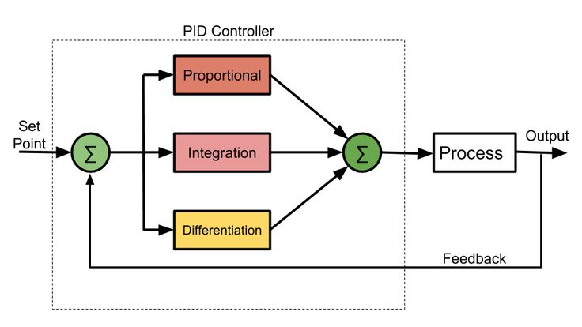
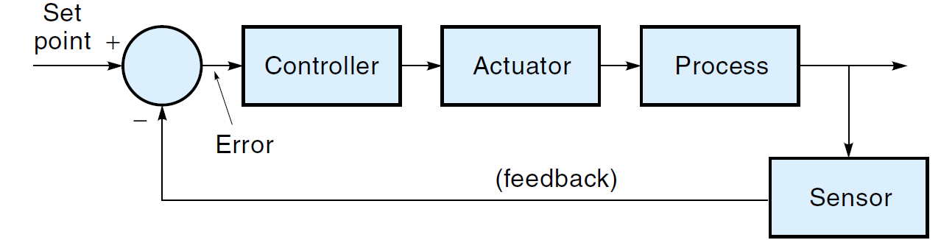
Feedback
Types of Feedback:
Stable – Convergent – Negative Feedback
Unstable – Divergent – Positive Feedback
Neutral – Oscillating – Neutral Feedback

Slide 7
Examples of Feedback Systems
Convergent Systems:
Suspension systems, spring-mass-damper
PID-controlled actuators, negative feedback amplifiers
Planetary orbits (energy wells), Lagrange points (local minima)
*Hopfield networks and Boltzmann machines
Neural networks, pattern recognition, and machine learning
Homeostasis (body temp, glycolysis, pH) and protein folding
Thermodynamic cooling laws and heat exchangers (thermal gradients)
Iterative root finding methods
*https://www.youtube.com/watch?v=1WPJdAW-sFo

Slide 8
Examples of Feedback Systems
Divergent Systems:
Inverted pendulum (without control)
Positive-feedback amplifiers
Fire ignition, combustion, diesel engine runaway, supercritical reactions
Unbounded weight updates in machine learning
Population explosion (exponential versus logistic)
Speculative markets, bubble feedback loops

Slide 9
Examples of Feedback Systems
Neutral Systems:
Ideal pendulum, frictionless oscillator
Ideal Keplerian planetary orbit
LC circuits without resistance
Pure imaginary eigenvalues, ideal center
Circular reasoning loops

Slide 10
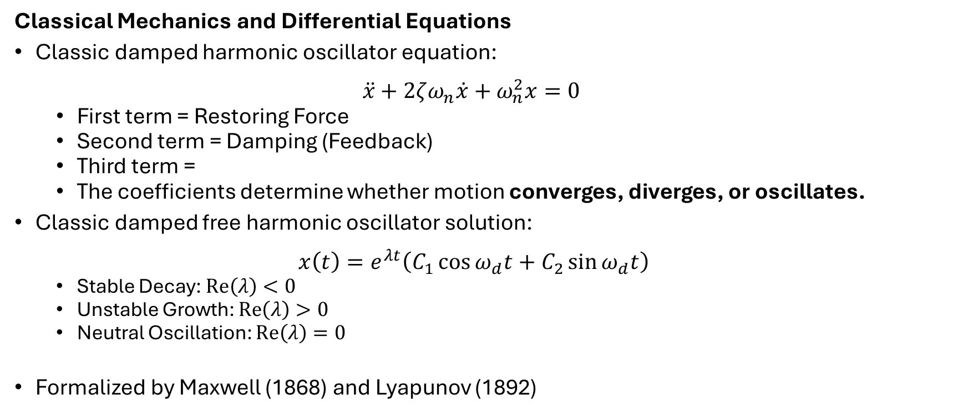
Mathematics of Stability
Classical Mechanics and Differential Equations
Classic damped harmonic oscillator equation: $\ddot{x}+2ζω_{n}\dot{x}+ω_{n}^{2}x=0$
First term = Restoring Force
Second term = Damping (Feedback)
Third term =
The coefficients determine whether motion converges, diverges, or oscillates.
Classic damped free harmonic oscillator solution: $x\left(t\right)=e^{λt}\left(C_{1}\cos{ω_{d}t}+C_{2}\sin{ω_{d}t}\right)$
Stable Decay: $Re\left(λ\right)<0$
Unstable Growth: $Re\left(λ\right)>0$
Neutral Oscillation: $Re\left(λ\right)=0$
Formalized by Maxwell (1868) and Lyapunov (1892)

Slide 11
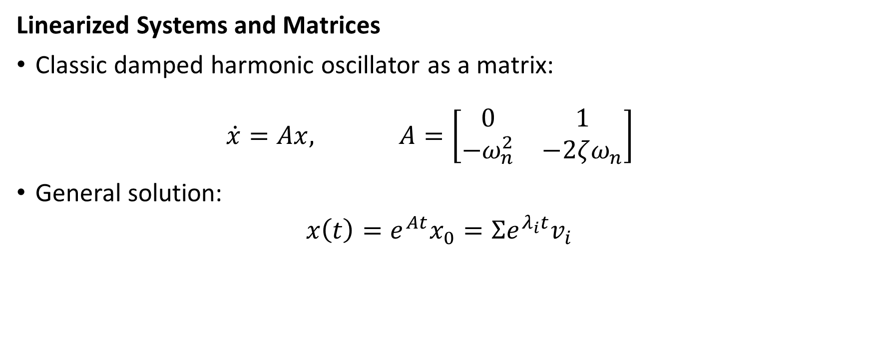
Mathematics of Stability
Linearized Systems and Matrices
Classic damped harmonic oscillator as a matrix: $\dot{x}=Ax, A=\left[\begin{matrix}0 & 1 \\ −ω_{n}^{2} & −2ζω_{n}\end{matrix}\right]$
General solution:
$$x\left(t\right)=e^{At}x_{0}=Σe^{λ_{i}t}v_{i}$$

Slide 12
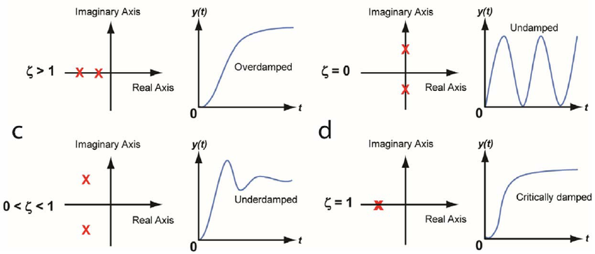
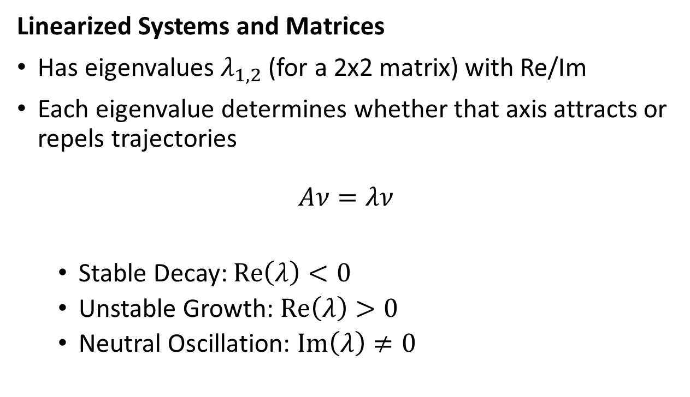
Mathematics of Stability
Linearized Systems and Matrices
Has eigenvalues $λ_{1,2}$ (for a 2x2 matrix) with Re/Im
Each eigenvalue determines whether that axis attracts or repels trajectories
$$Aν=λν$$
Stable Decay: $Re\left(λ\right)<0$
Unstable Growth: $Re\left(λ\right)>0$
Neutral Oscillation: $Im\left(λ\right)≠0$

Slide 13
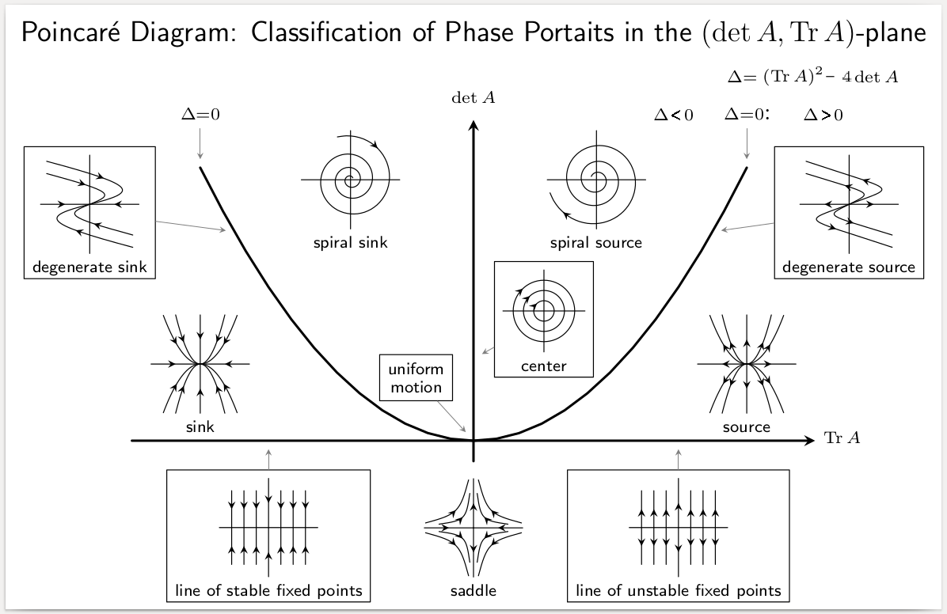
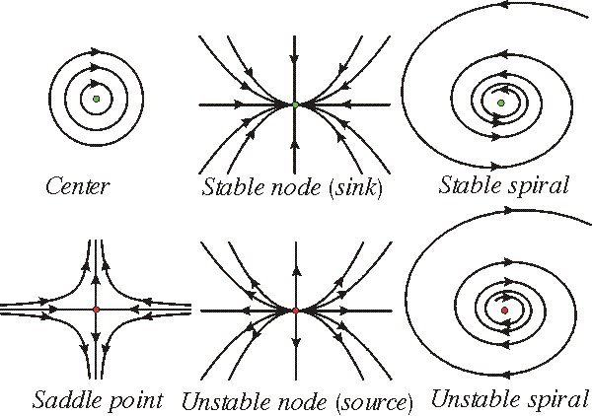
Visualizing Stability
Phase Portraits
https://www.larserikpersson.se/webcourse/ix-introduction-to-the-theory-of-dynamical-systems-chaos-stability-and-bifurcations/7-classification-of-critical-points/

Slide 14
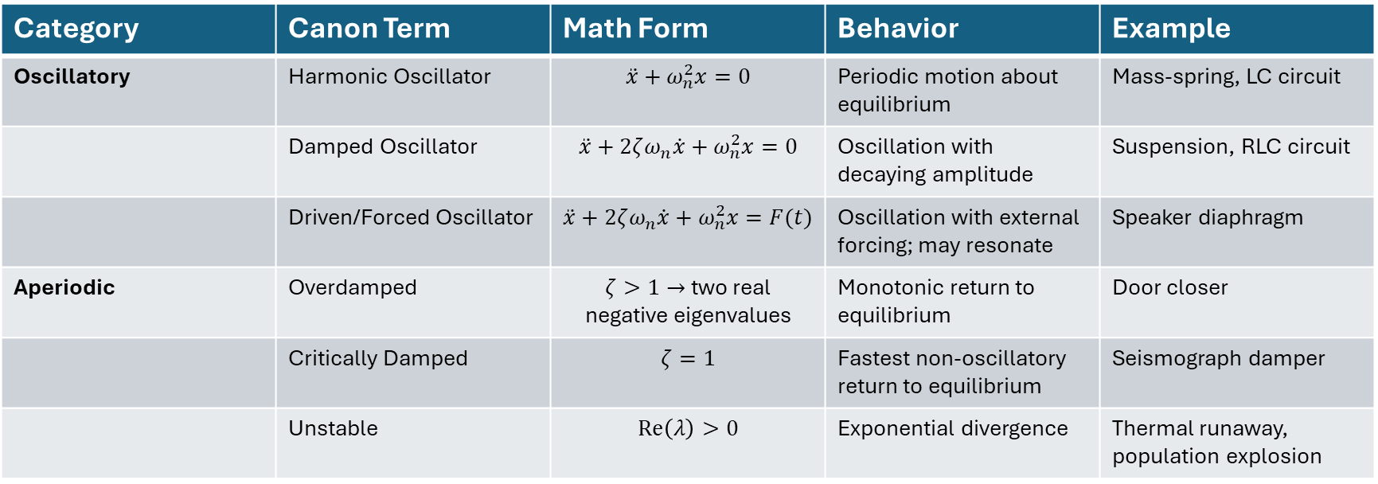
Language of Stability
Category | Canon Term | Math Form | Behavior | Example
Oscillatory | Harmonic Oscillator | $$\ddot{x}+ω_{n}^{2}x=0$$ | Periodic motion about equilibrium | Mass-spring, LC circuit
 | Damped Oscillator | $$\ddot{x}+2ζω_{n}\dot{x}+ω_{n}^{2}x=0$$ | Oscillation with decaying amplitude | Suspension, RLC circuit
 | Driven/Forced Oscillator | $$\ddot{x}+2ζω_{n}\dot{x}+ω_{n}^{2}x=F(t)$$ | Oscillation with external forcing; may resonate | Speaker diaphragm
Aperiodic | Overdamped | $ζ>1→$ two real negative eigenvalues | Monotonic return to equilibrium | Door closer
 | Critically Damped | $$ζ=1$$ | Fastest non-oscillatory return to equilibrium | Seismograph damper
 | Unstable | $$Re\left(λ\right)>0$$ | Exponential divergence | Thermal runaway, population explosion
Oscillatory vs aperiodic describes form of motion (harmonic, damped, overdamped)
Stable vs unstable describes direction of evolution (toward/away from equilibrium)
Free vs forced describes source of excitation (natural or driven)

Slide 15
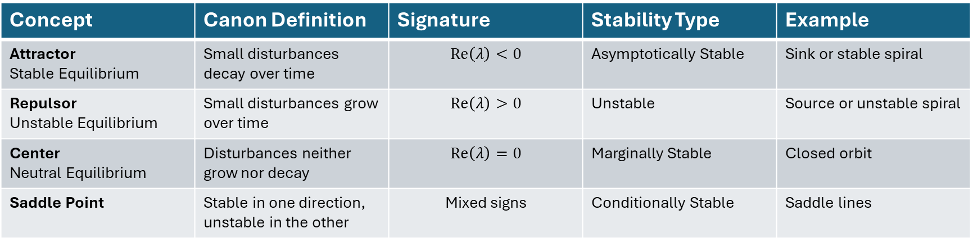
Language of Stability
Concept | Canon Definition | Signature | Stability Type | Example
Attractor Stable Equilibrium | Small disturbances decay over time | $$Re\left(λ\right)<0$$ | Asymptotically Stable | Sink or stable spiral
Repulsor Unstable Equilibrium | Small disturbances grow over time | $$Re\left(λ\right)>0$$ | Unstable | Source or unstable spiral
Center Neutral Equilibrium | Disturbances neither grow nor decay | $$Re\left(λ\right)=0$$ | Marginally Stable | Closed orbit
Saddle Point | Stable in one direction, unstable in the other | Mixed signs | Conditionally Stable | Saddle lines
Attractors and Repulsors
These are the fixed-point geometries in phase portraits
Each corresponds to a distinct pattern of eigenvalues

Slide 16
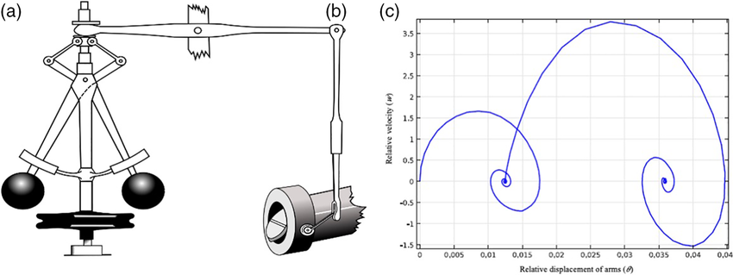
Four Modes of Motion
From James Clerk Maxwell’s On Governors (1868)
Stable decay (damped motion)
Unstable growth (runaway motion)
Stable oscillation (neutral, periodic)
Unstable oscillation (growing oscillations)

Slide 17
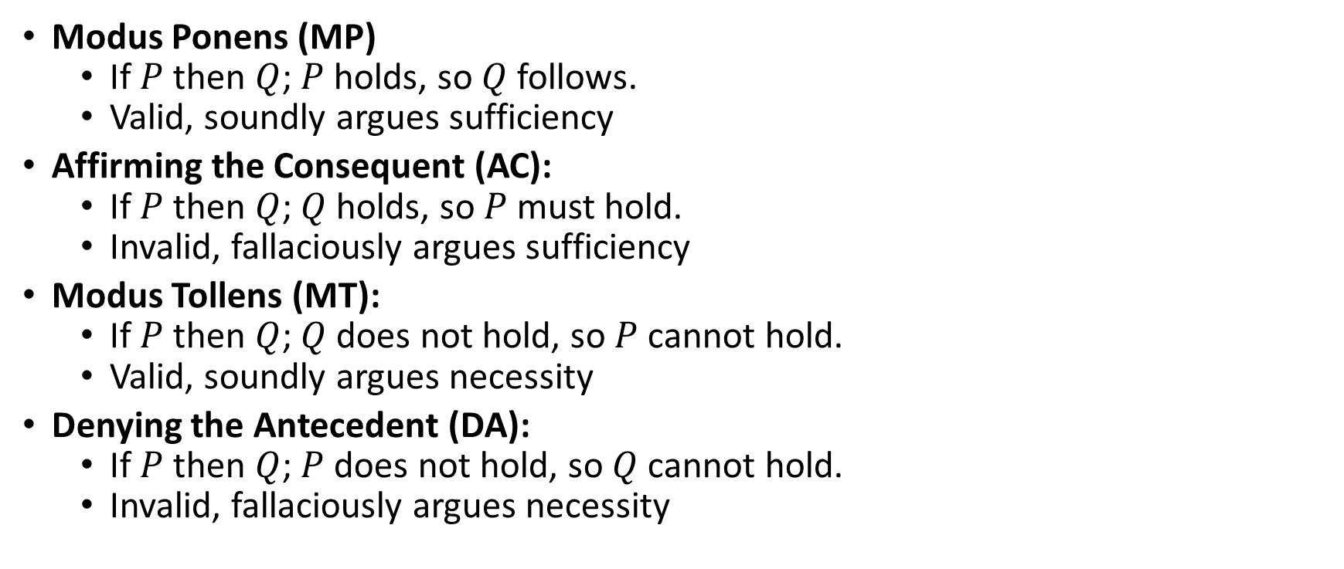
Four Modes of Inference
Modus Ponens (MP)
If $P$ then $Q$; $P$ holds, so $Q$ follows.
Valid, soundly argues sufficiency
Affirming the Consequent (AC):
If $P$ then $Q$; $Q$ holds, so $P$ must hold.
Invalid, fallaciously argues sufficiency
Modus Tollens (MT):
If $P$ then $Q$; $Q$ does not hold, so $P$ cannot hold.
Valid, soundly argues necessity
Denying the Antecedent (DA):
If $P$ then $Q$; $P$ does not hold, so $Q$ cannot hold.
Invalid, fallaciously argues necessity

Slide 18
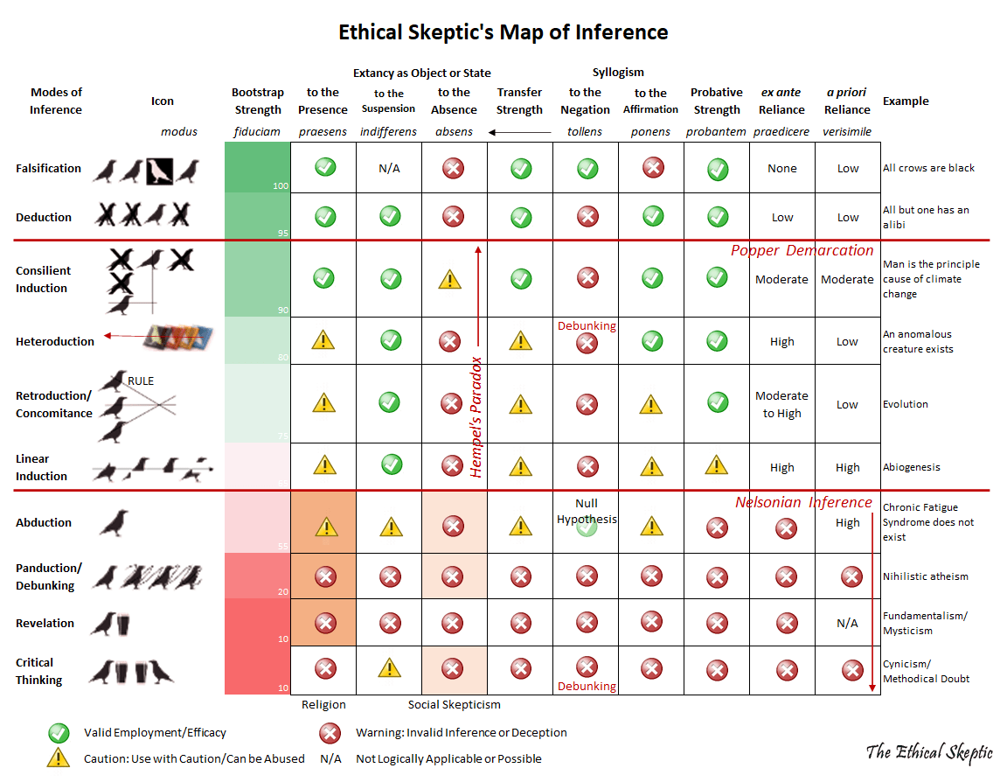
Comparing Modes of Inference

Slide 19
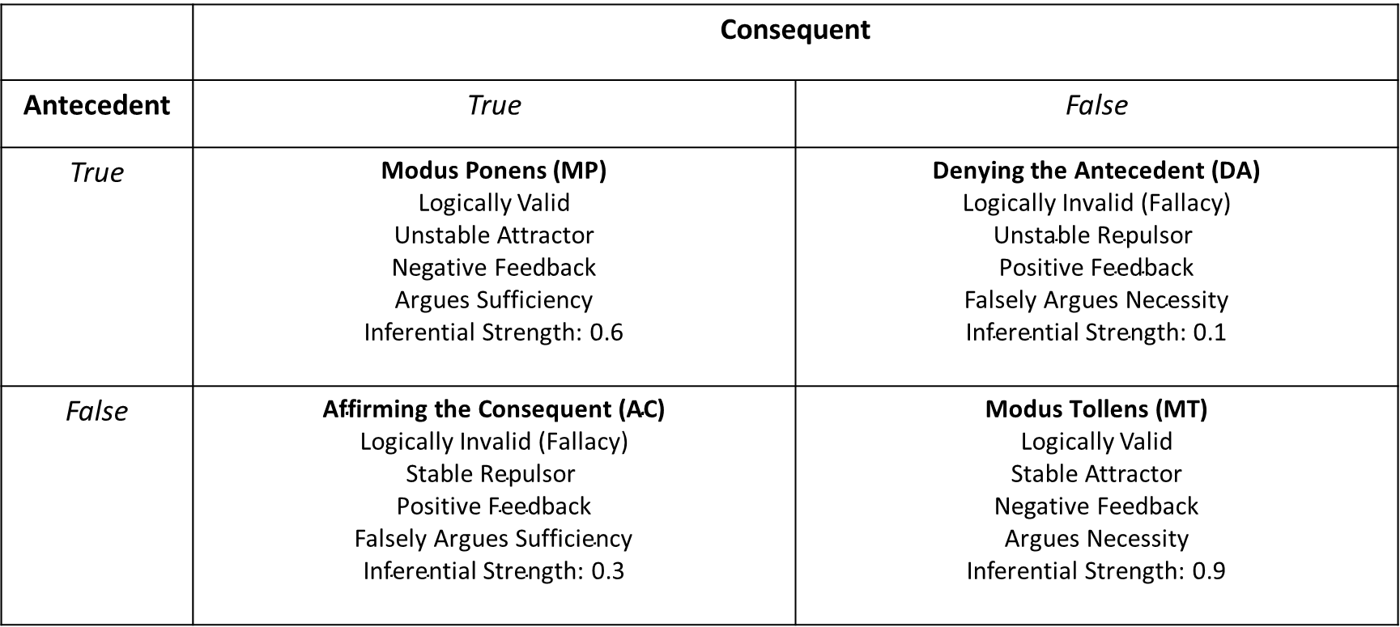
Inference Matrix
 | Consequent
Antecedent | True | False
True | Modus Ponens (MP) Logically Valid Unstable Attractor Negative Feedback Argues Sufficiency Inferential Strength: 0.6 | $$\text{Denying} \text{the} \text{Antecedent}\text{ (}\text{DA}\text{)}$$ $$\text{Logically} \text{Invalid}\text{ (}\text{Fallacy}\text{)}$$ $$\text{Unstable} \text{Repuls}\text{or}$$ $$\text{Positive} \text{Feedback}$$ Falsely $\text{Argues} \text{Necessity}$ $$\text{Inferential} \text{Strength}\text{: 0.1}$$
False | $$\text{Affirming} \text{the} \text{Consequent}\text{ (}\text{AC}\text{)}$$ $$\text{Logically} \text{Invalid}\text{ (}\text{Fallacy}\text{)}$$ $$\text{Stable} \text{Repuls}\text{or}$$ $$\text{Positive} \text{Feedback}$$ Falsely $\text{Argues} \text{Sufficiency}$ $$\text{Inferential} \text{Strength}\text{: 0.3}$$ | $$\text{Modus} \text{Toll}\text{ens}\text{ (}\text{MT}\text{)}$$ Logically Valid Stable Attractor Negative Feedback Argues Necessity Inferential Strength: 0.9

Slide 20
Inference as a Dynamic System
Can inference be described as a dynamical system?

Slide 21
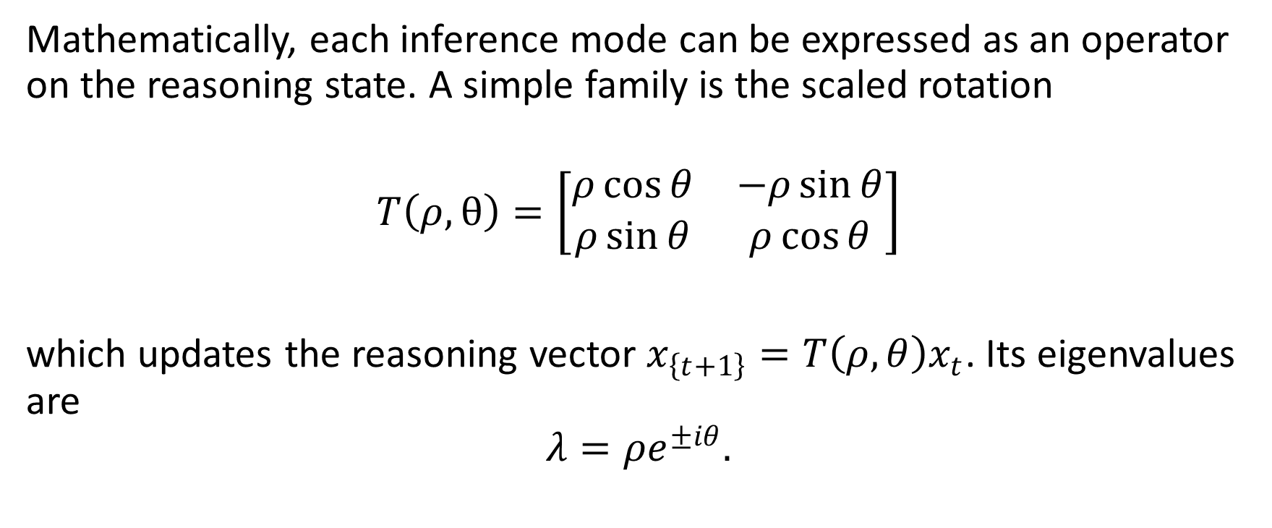
Inference as a Dynamic System
Mathematically, each inference mode can be expressed as an operator on the reasoning state. A simple family is the scaled rotation
$$T\left(ρ,θ\right)=\left[\begin{matrix}ρ\cos{θ} & −ρ\sin{θ} \\ ρ\sin{θ} & ρ\cos{θ}\end{matrix}\right]$$
which updates the reasoning vector $x_{\left\{t+1\right\}}=T\left(ρ,θ\right)x_{t}$. Its eigenvalues are
$$λ=ρe^{±iθ}.$$

Slide 22
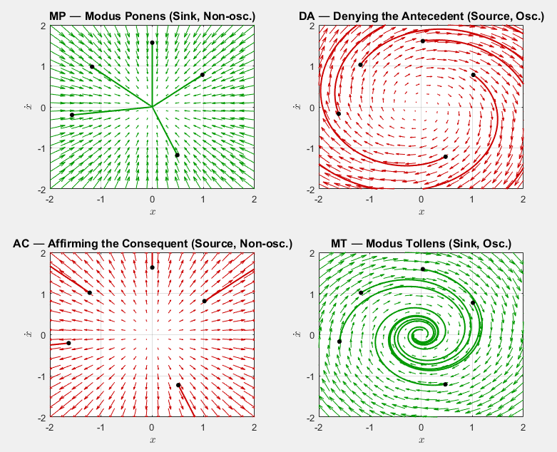

Slide 23
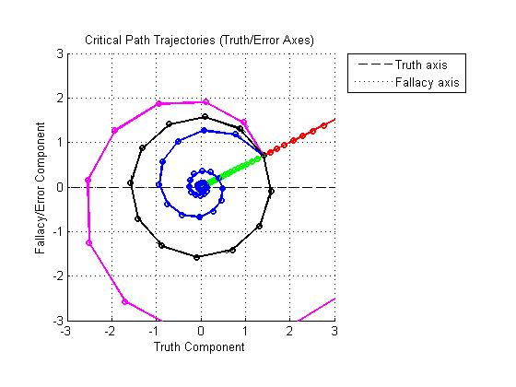
Inference as a Dynamic System
Valid Inference (MP, MT):
Attractor
Sink
Negative feedback
Damping
Convergence
Invalid Inference (DA, AC):
Repulsor
Source
Positive Feedback
Runaway
Divergence
Circular Inference
Neutral Orbit (Center)
Selective Inference
Saddle Point

Slide 24
Truth as the Stable Attractor of Reasoning
The rational diagonal (MP, MT) functions as negative feedback. Valid inferences damp error and converge reasoning toward stability.
Rational propaganda (Huxley)
The irrational diagonal (AC, DA) functions as positive feedback. Fallacies amplify error, producing divergence or oscillation.
Irrational propaganda (Huxley)
Fallacies push trajectories away; valid inference pulls trajectories in.

Slide 25
Geometry of Inference
“For the Greeks, it wasn’t enough for math to just be useful. They wanted geometry to address deeply philosophical questions...”
... [they] had a culture of antagonistic debate where the very nature of absolute truth was hotly contested.” – Ben Syverson
https://www.youtube.com/watch?v=M-MgQC6z3VU

Slide 26
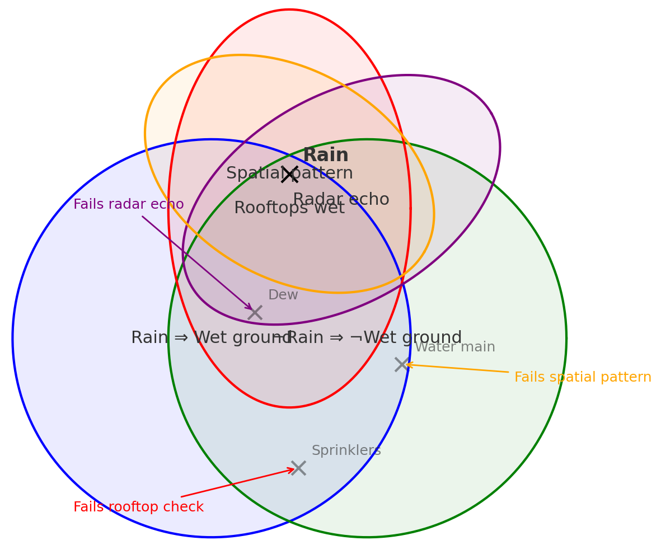
Line of Reasoning and Critical Path

Slide 27
Summary
Posture:
Epistemic humility (be willing to be wrong)
Deontological doubt (moral duty to avoid false positives)
Ontological confidence (reality has structure, which can be probed).
Aim:
Seek truth through coherence and invariance rather than stacking “facts.”
Ethic:
Prefer a non-answer to a confidently false answer. Minimize doubt; don’t enshrine beliefs.
Thesis:
Truth is what survives inversion; in dynamical terms, it behaves like an attractor.
A good model converges toward equilibrium under perturbation and feedback.

Slide 28
Historical Anchors
Historical Anchors:
Aristotle on motion, necessity/sufficiency, and falsification.
Physics and Posterior Analytics (350 BCE).
Galileo on inertia and falsification of Aristotelian motion.
Dialogue (1632), Two New Sciences (1638).
Maxwell’s On Governors as the birth of control theory.
On Governors (1868)
Peirce: Truth as the stable outcome of inquiry.
“How to Make Our Ideas Clear,” Popular Science Monthly (1878).

Slide 29
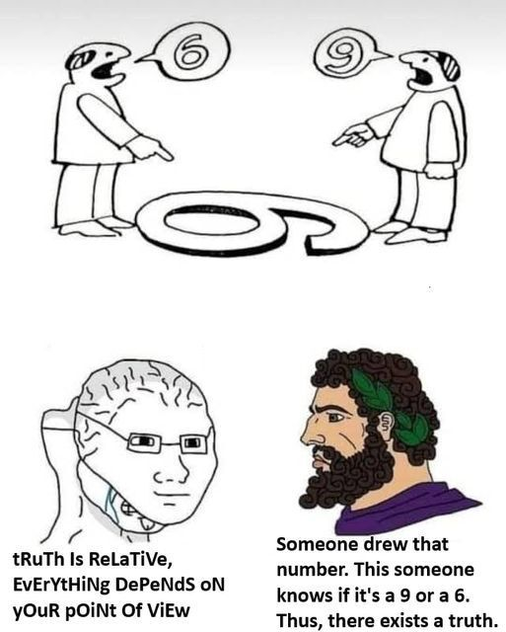
Conclusion
“You know, nature does not contradict itself.” - Viktor Blåsjö
Don’t fear being wrong, fear not being informative.
Error is acceptable; fragility is not.
Belief insists. Truth persists.

Slide 30
Discussion and Questions
Thoughts?
Comments?
Questions?

